Slide 1
External Teaming
Integrating Renewable and Nuclear Energy Sources
Presented by: Joseph Lee

Slide 2
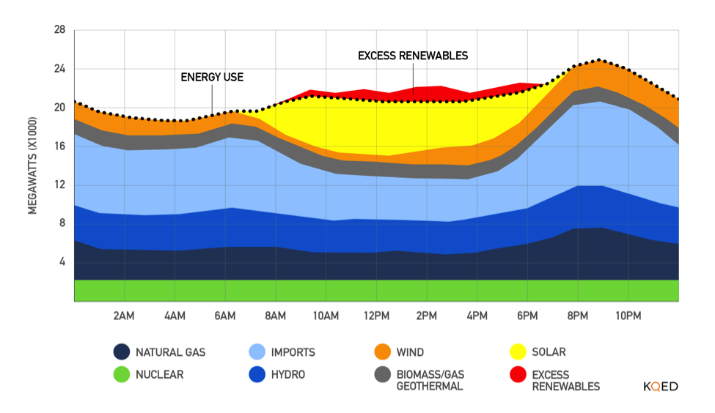
Project overview: The issue
Notes:
With greater renewable energy production in the recent years, electricity supply into the grid has become more unpredictable. This of course is because we don’t control the blowing of the wind nor the shining of the sun. This lack of predictability can lead to a supply of electricity greater than the demand as shown here which negatively affects the price of electricity. In order to add stability to the grid, we are proposing a method to allow nuclear power plants (or base load operating plants in general) to alter its electricity output (or load follow) to a given demand.

Slide 3
Nuclear-Renewable Hybrid System
Electricity Production
Thermal Energy
Hydrogen Production
Notes:
The solution is often referred as a nuclear hybrid system where energy from the nuclear power plant can either be used to produce electricity or some secondary good which in our case is hydrogen. So at times of high electricity demand, all the energy can be sent for electricity production. At moderate demand, some energy can be sent to hydrogen production, and as you might guess, at low energy demand, most of the energy can be diverted to hydrogen production. Our project focuses on characterizing a model for this system and analyzing the economic benefit from the interconnection

Slide 4
Stakeholder Interest and Expectations
Stakeholder | Interests/Expectations | Importance
Advisor: Max Fratoni | Valid characterization of the system Setting realistic goals | 5
Team Members | Technical Experience Creating a perfect model | 5
Fung Institute | Prestige Deliverables with an ambiguous audience Excessive deliverables | 3
Energy Generation Organizations | Proof of viable model Economic feasibility of system | 1
Notes:
Given that this project is so theoretical and in its early stages, our stakeholders are mostly limited to the berkeley space. There are four main stakeholders. The first and most important is our advisor who is looking for a valid characterization of this hybrid system and continues to highlight setting realistic goals for this project.
Then we have the project team members who are looking to receive technical experience from this project and since we’re rather optimistic, we started off wanting to create the perfect model for this interconnection
Then we have the fung institute who is benefits from the success and findings of our project. One issue we’ve found is that the deliverables expected of us have had ambiguous audiences making it difficult to tailor presentations and papers. Additionally, there seemed to be an excessive number of deliverables for the capstone project and not enough deliberation of feedback of those deliverables.
While they’re not in the picture yet, way down the line, energy generation organizations may be interested in our results to determine the viability of a hybrid system. Additionally, they’d want to know how economically viable this system is to see if its worth putting in the effort.

Slide 5
Stakeholder Action Plan
Issue | Action | Comment
Aiming to create a perfect model | Focus on key components of the model and then branch out | It’s better to have a minimally function model than no model at all
Economic feasibility of interconnection | Identify ways to make the interconnection cheaper | Economics is the main driver in whether something gets done or not
Excessive deliverables | Meet with GSI more often or ask for more feedback | Taking more time analyzing the deliverables will make them more meaningful

Slide 6
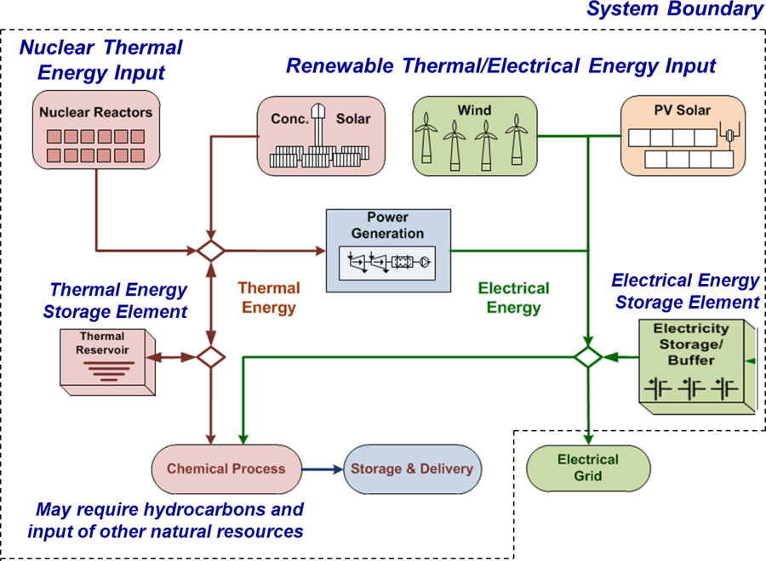
Questions?

